Slide 1

Simplifying Cluster scaling with Karpenter on Kubernetes
Cloud Native NoVA
Rodrigo Bersa
WW Senior Container Specialist SA
Amazon Web Services

Slide 2
Agenda
What is Karpenter?
How Karpenter works
Demo
Wrap up & resources
QA

Slide 3
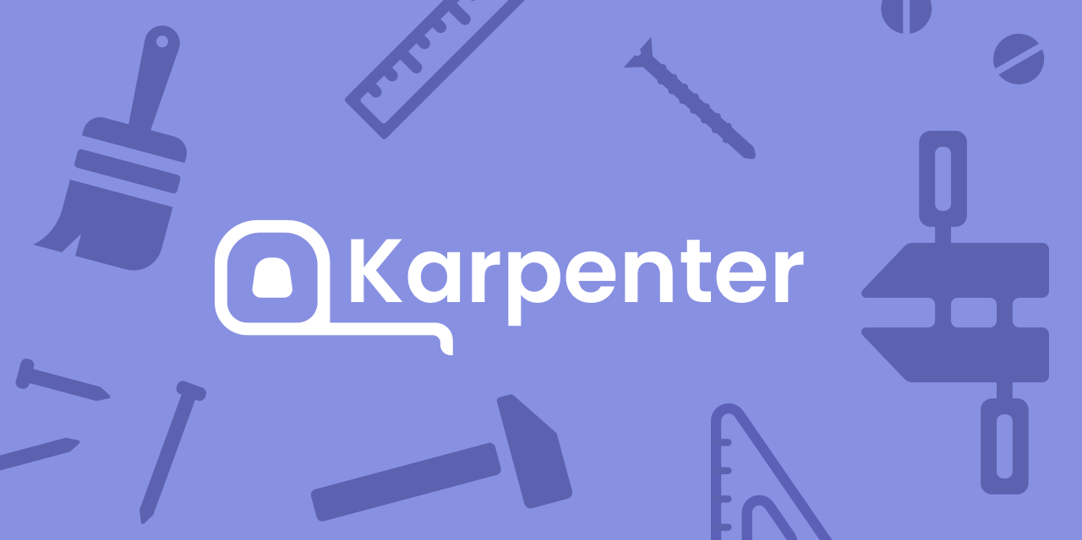
What is Karpenter?
Karpenter is open-source, flexible, and high-performance node lifecycle management project built for Kubernetes, that simplifies infrastructure with the right nodes at the right time.

Slide 4

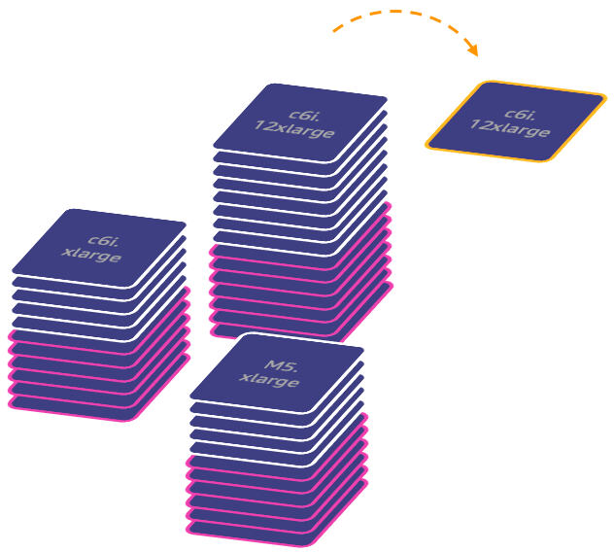
Right sized scaling
Application first infrastructure
Node provisioning based on Pod requirements, improving application availability by responding faster
Simplified Configuration
Minimizes operational overhead with opinionated defaults and Kubernetes-native CRDs in a single configuration
Diversify with Spot and On-Demand
Karpenter helps simplify diversification across purchase options and instance types
Automated Node consolidation
Lowers costs by constantly looking for ways to improve efficiency on right sized compute
Notes:
Like CAS, Karpenter is an open source project, created initially by AWS and donated to the community.
Karpenter simplifies Kubernetes infrastructure with the right nodes at the right time (or just in time).
Karpenter provides an application first infrastructure by provisioning nodes based on pod requirements
Karpenter uses Kubernetes native concepts with a single configuration to support a variety of compute instance types, including Spot, On-Demand, x86 and ARM from a single configuration
It also enables support for diversification across purchasing options with Spot and on-demand
Karpenter is fully supported by AWS, launched for GA in 2021

Slide 5










Kubernetes Autoscaling Overview
Horizontal Pod Autoscaling (HPA)
Vertical Pod Autoscaling (VPA)
HPA
Metrics
Store
VPA
Cluster Autoscaler (CAS)
X
Pending pods
CAS
Karpenter
Just-in-time capacity
Pending pods
Unschedulable pods
Notes:
+Cluster proportion autoscaler

Slide 6
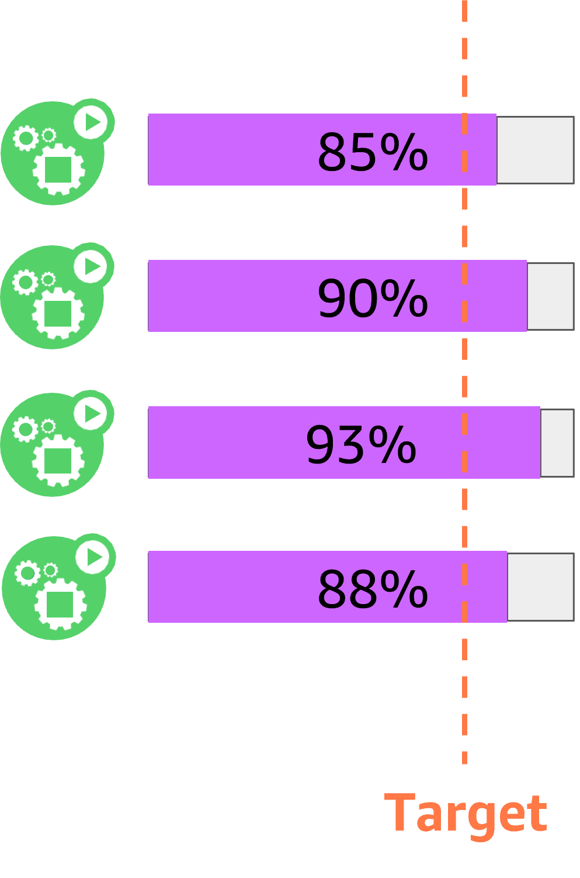
Karpenter Scale-Out
HPA >> Pending pods
Kubernetes
Default: all standard instance types
x sec
OR
New node
Instance Families:
[m5, m5a, m6i, …]
Provisioning and scheduling decisions
Works with kube-scheduler to provision the right set of nodes
Supports all scheduling constraints: Topology Spread, Node/Pod Affinity and Anti-Affinity, etc
Node
1 vCPU request

Slide 7
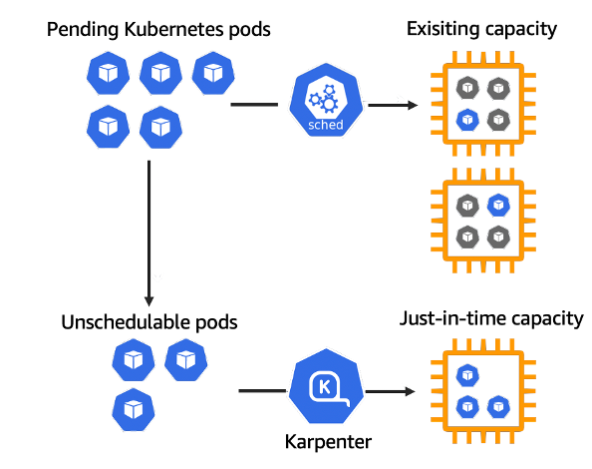
Karpenter
Node provisioning
Kube Scheduler gets the first crack at scheduling pending pods. Tries to schedule on existing capacity
Karpenter observes aggregate resource requests of unschedulable pods set by kube scheduler) to make decisions on what instances to launch

Slide 8
Karpenter Scale-In
HPA << Pending pods
Karpenter
Consolidation actively seeks out opportunities to make the cluster more cost efficient
Terminations
Replace underutilized nodes with more efficient compute
Node Expiration TTL
kubectl delete node with graceful draining
Node
1 vCPU request

Slide 9


Karpenter
Binpacking
Memory (GB)
Online binpacking
16
14
12
10
8
Well-known labels
6
4
karpenter.sh/capacity-type=spot
karpenter.k8s.aws/instance-family=m6i
kubernetes.io/arch=arm64
topology.Kubernetes.io/zone=us-west-2a
2
vCPUs
1
2
3
4
Notes:
Bin packing problem:
https://github.com/aws/karpenter/blob/main/designs/bin-packing.md
https://en.wikipedia.org/wiki/Bin_packing_problem#First_Fit_Decreasing_(FFD)
Pods of different sizes must be packed into a finite number of nodes (each with a fixed capacity size), in a way that minimum number of nodes(bins) are used.
First-fit descending or First fit decreasing:
First sort the pods by size from biggest to smallest.
Attempt to pack pods (biggest to smallest). Biggest pods will leave some gaps in nodes and smaller ones will pack there
First-Fit descending
Multidimensional knapsack
CPU, memory, euclidean
Other algorithms

Slide 10


How Karpenter works
HPA
Pending pods
EC2 Fleet (instant)
CA
ASG
Consolidates instance orchestration responsibilities within a single system

Slide 11
Benefits of leveraging Karpenter
Node consolidation
Operational efficiency
Cost Optimization
Application Availability
Node auto-provisioning
Simplified Resource management
Rapid scaling
Compute availability
Optimal Compute Infrastructure E.g. Intel, Graviton, GPUs
Flexibility E.g. No need to configure every node group)
Increases utilization E.g. Consolidates and bin packs pods to fewer node groups
Lowers costs E.g. consolidation from On-Demand->On-Demand, On-Demand->EC2 Spot
Faster E.g. responds quickly and automatically to changes in application load, scheduling, and resource requirements
Easy upgrades
Efficient management E.g. many clusters and node groups
Mixes purchasing options as needed E.g. Prioritizes Spot, pulls in On-Demand if Spot is not available
Notes:
Amazon EC2 offers four different purchasing options to provision compute: *Click*
On-Demand: You provision instances when you need them. *Click*. Pay-as-you-go, pay by the second, no up front commitments, this is where most customers start their cloud journey. When comparing with other purchase options it’s almost like our premium purchase option, and its great for short-term usage.
*Click*
Reserved Instance: *Click* - Is ideal for customers who know exactly what they are going to run over a duration, and offers big savings for a 1 or 3 year commitment. Best for always on workloads
Savings Plans: Just like RI’s, but rather than making commitments to specific instance configuration, you can save money just by committing to a dollar spend. Super flexible and allow you to change that usage from one region to another, or from instance type to another, or even if you move from EC2 to Fargate, the savings plan moves with you.
*Click*
Spot Instances: Is making use of AWS’ spare capacity to provision instances at a highly discounted rate. *Click* Same as pay-as-you-go pricing as On-Demand, but at up to 90% off. Best for stateless, flexible, and fault tolerant workloads. The caveat with this discount and spare-capacity is that EC2 can reclaim that instance with proactive/reactive (2 minute) warning.
Efficienct management large EKS environment with many clusters and nodes at scale through upgrades
Consolidates and bin packs pods to fewer node groups to increase utilization. Chooses the lowest priced instances for OD. It does consolidation from OD->OD, OD->Spot.
Karpenter responds quickly and automatically to changes in application load, scheduling, and resource requirements, placing new workloads onto a variety of available compute resource capacity.
Ensures compute availability
With mixing purchasing options with Spot and OD, RIs.

Slide 12












Compute flexibility with Karpenter
EKS Cluster
Karpenter Provisioner
AZ 1
AZ 2
AZ 3
P4
g5
g4
Notes:
Karpenter provides great flexibility in compute provisioning on different dimensions (instance types, sizes, purchase options, cpu architectures, gpu accelerated, availability zones). Karpenter achieves this without Autoscaling Groups. Karpenter is also a good example of how EC2 Fleet “Instant” mode can be used for just-in time compute provisioning and scaling

Slide 13

























Infrastructure layout
AWS Cloud
Availability Zone 1
Availability Zone 2
Availability Zone 3
VPC
Amazon Elastic Kubernetes Service (Amazon EKS)
Fargate
Profiles
kube-system
karpenter
Karpenter
default
cost-optimization
gpu

Slide 14



Kubernetes layout
AWS Cloud
Amazon EKS
Fargate Profiles
kube-system
karpenter
Karpenter
default
gpu-operator
kubecost
cost-optimization
default
inflate
gpu
gpu

Slide 15
“Demo”

Slide 16
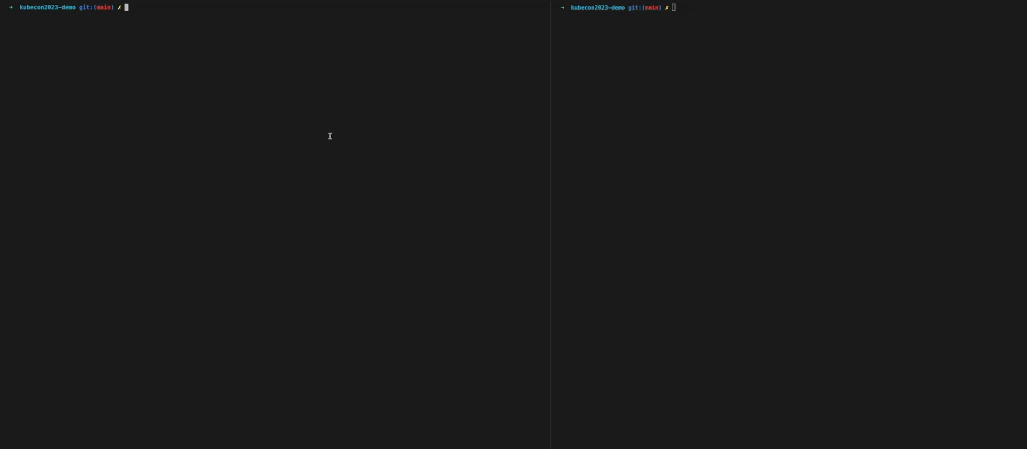

Slide 17
Key take-aways
Leverage Karpenter for operational efficiency, cost optimization and application availability
Scale large, heterogenous EKS environments with many clusters with Karpenter
Karpenter helps with diversification and hence scales well with EC2 Spot

Slide 18


Session resources
https://github.com/rodrigobersa/public-resources
https://github.com/aws-samples/karpenter-blueprints

Slide 19
Additional resources
Karpenter : https://karpenter.sh
Karpenter Best Practices: https://aws.github.io/aws-eks-best-practices/karpenter/
Karpenter workshop: https://ec2spotworkshops.com/karpenter.html
Launch Blog: https://aws.amazon.com/blogs/aws/introducing-karpenter-an-open-source-high-performance-kubernetes-cluster-autoscaler/
Blog post: https://aws.amazon.com/blogs/containers/using-amazon-ec2-spot-instances-with-karpenter/
Blog post: https://aws.amazon.com/blogs/apn/best-practices-for-optimizing-kubernetes-costs-on-aws-with-stormforge-and-karpenter/

Slide 20

Rodrigo Bersa
bersr@amazon.com
linkedin.com/in/bersa

Slide 21
Appendix A – Karpenter v1beta

Slide 22
v1beta1 Overview
Changes to the Karpenter APIs have been introduced in Karpenter v0.32.x. The v1beta1 changes are meant to simplify and improve ease of use of those APIs, as well as solidify the APIs for the v1 release.
In Karpenter v0.32.x v1alpha5 APIs will coexist alongside v1beta1 to support a transition.
From Karpenter 0.33.0 v1alpha1 APIs will be removed.

Slide 23
Change in terminology
Provisioner -> NodePool
AWSNodeTemplate -> EC2NodeClass
Machine -> NodeClaim

Slide 24
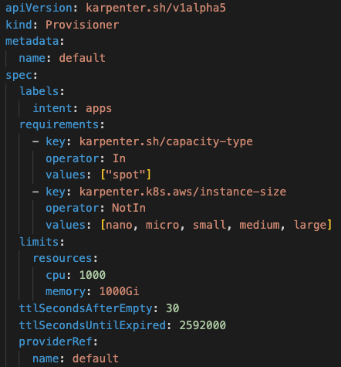
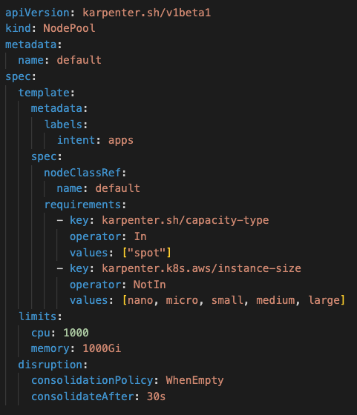
Change in Spec

Slide 25
Change in Spec

Slide 26
Change in Spec

Slide 27
Change in Spec

Slide 28
Change in Spec

Slide 29
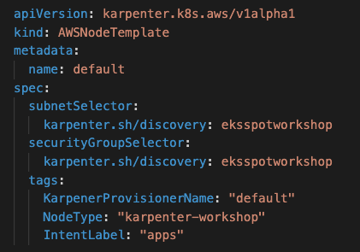
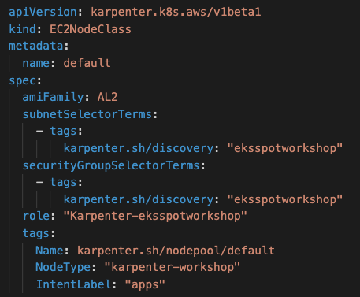
Change in Spec

Slide 30
Change in Spec

Slide 31
Change in Spec
Note
amiFamily – mandatory field.
Options include: AL2, Bottlerocket, Ubuntu, Windows2019, Windows2022, Custom

Slide 32
Change in Spec
Note
Default EC2 Name Tag has changed from Karpenter NodePool name to the host name. To keep the Provisioner/NodePool name set the tag property.

Slide 33
Change in Spec
Note
role: new mandatory field.
spec.instanceProfile field has been removed from the EC2NodeClass in favor of the spec.role field.
Karpenter is also removing support for the defaultInstanceProfile specified globally in the karpenter-global-settings ConfigMap.
Karpenter will now auto-generate the instance profile in your EC2NodeClass, given the role that you specify.

Slide 34
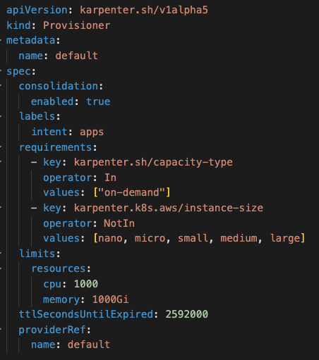
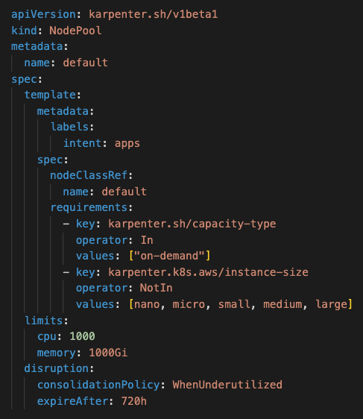
Change in Spec – Consolidation
Set to “Never” to never expire nodes

Slide 35
Change in Global settings configuration
Prior to Karpenter version 0.32.0 a ConfigMap named karpenter-global-settings was used to configure Karpenter (e.g. interruption queue name, batch intervals)
This has now been deprecated in favour of environment variables part of the Karpenter controller Deployment object.

Slide 36
Change in configuration – Example
Note
< v0.32.x Key | >= v0.32.x Key
controller.outputPaths | logConfig.outputPaths
controller.errorOutputPaths | logConfig.errorOutputPaths
controller.logLevel | logConfig.logLevel.controller
webhook.logLevel | logConfig.logLevel.webhook
logEncoding | logConfig.logEncoding
settings.aws.assumeRoleARN | settings.assumeRoleARN
settings.aws.assumeRoleDuration | settings.assumeRoleDuration
settings.aws.clusterCABundle | settings.clusterCABundle
settings.aws.clusterName | settings.clusterName
settings.aws.clusterEndpoint | settings.clusterEndpoint
settings.aws.isolatedVPC | settings.isolatedVPC
settings.aws.vmMemoryOverheadPercent | settings.vmMemoryOverheadPercent
settings.aws.interruptionQueueName | settings.interruptionQueue
settings.aws.reservedENIs | settings.reservedENIs
settings.featureGates.driftEnabled | settings.featureGates.drift
settings.aws.defaultInstanceProfile | Dropped
settings.aws.enablePodENI | Dropped
settings.aws.enableENILimitedPodDensity | Dropped
settings.aws.tags | Dropped

Slide 37
Change in AWS IAM Permissions
New Karpenter controller IRSA permission needed:
"iam:AddRoleToInstanceProfile"
"iam:CreateInstanceProfile"
"iam:DeleteInstanceProfile"
"iam:GetInstanceProfile"
"iam:RemoveRoleFromInstanceProfile"
"iam:TagInstanceProfile"
Why? Karpenter will now auto-generate the instance profile in your EC2NodeClass, given the role that you specify in the EC2NodeClass.

Slide 38
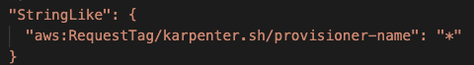
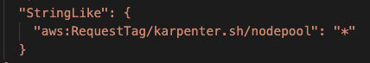
Change in AWS IAM Permissions
Note: if transitioning between alpha and beta consider the IAM Condition request name change, suggest adding a beta and alpha IAM policies to the IAM role used by the Karpenter controller:

Slide 39
Change in Pod annotations to control voluntary disruptions
karpenter.sh/do-not-evict
karpenter.sh/do-not-consolidate
karpenter.sh/do-not-disrupt
v1alpha5
v1beta1

Slide 40
Rolling over nodes to v1beta1

Slide 41
Simplify your transition with karpenter-convert tool
karpenter-convert is a simple CLI tool to bump the API manifests from alpha to beta. It converts v1alpha5/Provisioner to v1beta1/NodePool and v1alpha1/AWSNodeTemplate to v1beta1/EC2NodeClass:
https://github.com/aws/karpenter/tree/main/tools/karpenter-convert

Slide 42
Rolling over nodes to the new NodePool
Option 1: Periodic Rolling with Drift: Enable drift in your NodePool file, then do the following:
Add the following taint to the old Provisioner: karpenter.sh/legacy=true:NoSchedule
Wait as Karpenter marks all machines owned by that Provisioner as having drifted.
Watch as replacement nodes are launched from the new NodePool resource.
Because Karpenter will only roll of one node at a time, it may take some time for Karpenter to completely roll all nodes under a Provisioner.
Option 2: Forced Deletion: For each Provisioner in your cluster:
Delete the old Provisioner with: kubectl delete provisioner <provisioner-name> --cascade=foreground
Wait as Karpenter deletes all the Provisioner’s nodes. All nodes will drain simultaneously. New nodes are launched after the old ones have been drained.
Option 3: Manual Rolling: For each Provisioner in your cluster:
Add the following taint to the old Provisioner: karpenter.sh/legacy=true:NoSchedule
For all the nodes owned by the Provisioner, delete one at a time as follows: kubectl delete node <node-name>
Notes:
From: https://karpenter.sh/docs/upgrading/v1beta1-migration/

Slide 43
Rolling over nodes to the new NodePool
Control pod termination during voluntary disruptions, consider Pod Disruption Budgets.
Or Pod readiness gates to avoid timeouts with AWS Load Balancer Controller during target registration for IP target type
apiVersion: policy/v1
kind: PodDisruptionBudget
metadata:
name: my-app
spec:
minAvailable: 20
selector:
matchLabels:
app: my-scaled-app
https://kubernetes-sigs.github.io/aws-load-balancer-controller/v2.1/deploy/pod_readiness_gate/

Slide 44
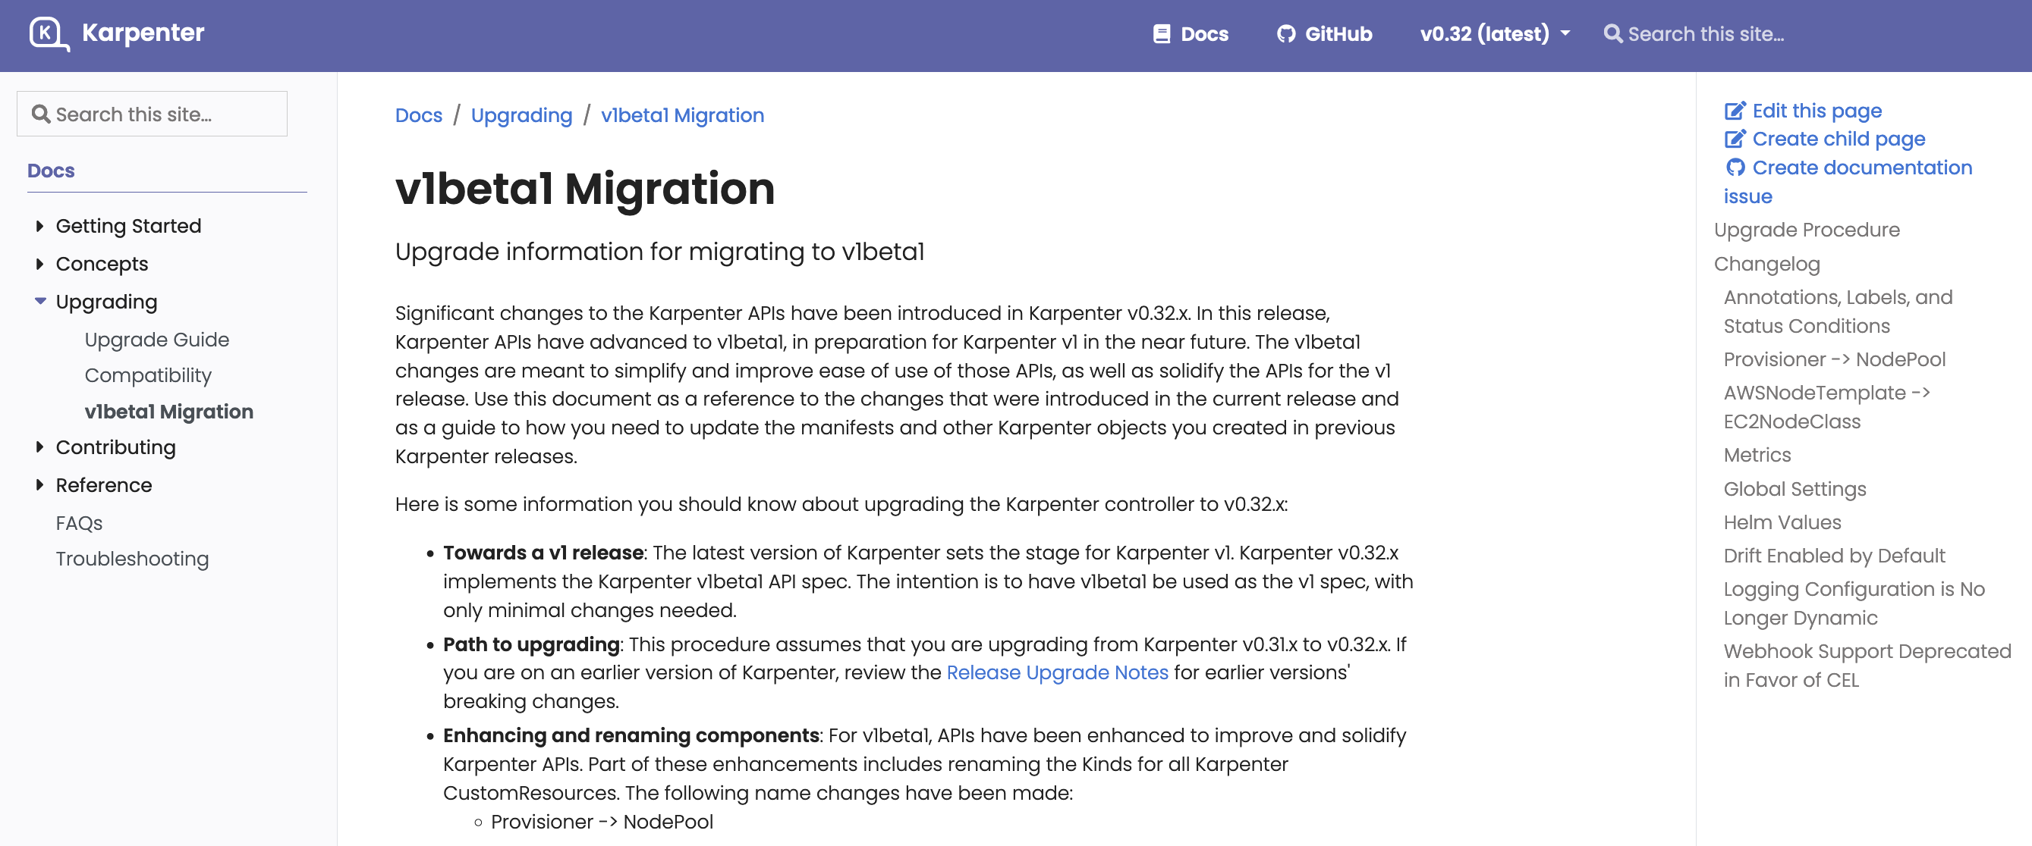
Next steps
For in-depth v1alpha5 to v1beta1 migration guidance check out the migration guide In the Karpenter documentation:
https://karpenter.sh/docs/upgrading/v1beta1-migration/

